Slide 1
XGBoost Algorithm
XGBoost creates decision trees using an ensemble learning approach, also known as extreme gradient boosting.

Slide 2
How trees are formed in XG Boost
The basic idea behind gradient boosting is to train weak learners in a sequential manner and combine their predictions to form a strong model.

Slide 3
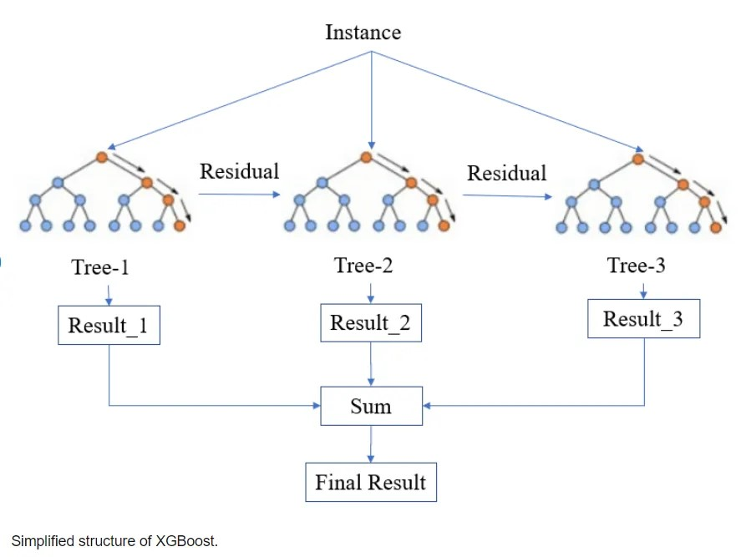
Simplified Structure of XGBoost

Slide 4
Steps involved in creating trees in XGBoost
Compute
Fit
Compute New
Combine
Initialize

Slide 5
Simplified explanation of how XGBoost works
Initialize the base learner
Compute the residuals
Build a Tree to Predict Residuals
Update Predictions
Calculate New Residuals
Build Another Tree
Combine Predictions

Slide 6
Advantages of XGBoost
Scalability
Speed
Flexibility
Robustness
High accuracy

Slide 7
Overall, XGBoost is a powerful and widely used machine learning algorithm that is well-suited for large-scale data problems. Its speed and accuracy make it a popular choice for many machine learning tasks, but it is important to consider the complexity and over fitting risk when deciding whether it is the best algorithm for a particular use case.

